Slide 1


Key-Value Databases REDIS
José Alberto Benítez-Andrades, Ph.D. – jbena@unileon.es
Assistant Professor
Universidad de León
Notes:
Good morning everyone, first of all, I would like to thank Deveeshree for inviting me to give these seminars, it is a pleasure for me. It is a pleasure to collaborate with the University of Washington, U DAB.
Thank you for inviting me to give this seminar.
I wish I could explain in more detail the 4 types of NoSQL databases I mentioned the other day, document-based, key-value, columnar and graph databases, but in one session I can only explain one of them in detail. For this reason I have chosen to dedicate this seminar to key-value databases, specifically REDIS.

Slide 2
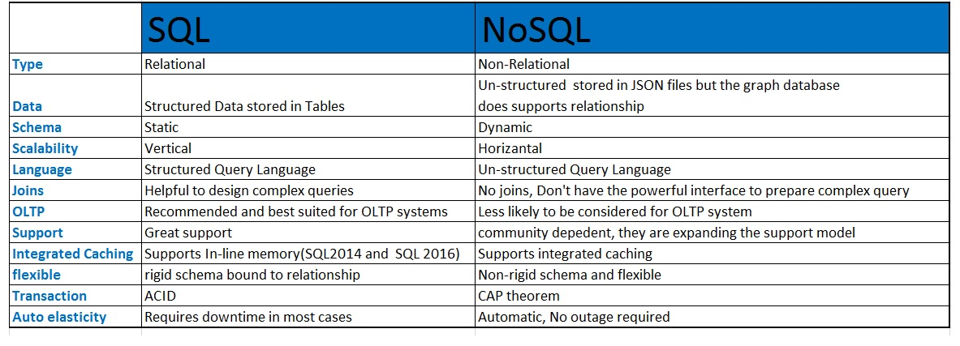
RDBMS (SQL) vs NoSQL
Notes:
By way of summary, with respect to the other day, just to recall some of the characteristics we saw between SQL and No-SQL, RDBMS and Non RDBMS databases.
In relation to the type of data, SQL stored structured data in tables and No-SQL, generally, unstructured.
The schema in SQL was static and in No-SQL dynamic.
Scalability in SQL was vertical, which meant that an increase in data would lead to an increase in hardware costs, which was not the case in No-SQL.
Generally, NoSQL does not accept JOIN queries.
And the transactions we just mentioned how NoSQL follows the CAP vs ACID theorem in the case of SQL databases.

Slide 3
REDIS
REDIS bibliography:
https://learning.oreilly.com/library/view/learning-REDIS/9781783980123/
https://learning.oreilly.com/library/view/REDIS-4x-cookbook/9781783988167/
https://REDIS.io/
Notes:
Today I am going to talk about REDIS which is a type of key-value database.
Information is available on these websites.

Slide 4
REDIS
Introduction
Features
Architecture
Data Structures
Development tools
Data modelling
Programmatic access to REDIS
Clustering in REDIS
Use cases
REDIS use cases
Graphical tools

Slide 5
REDIS - Introduction
REDIS is one of the most popular NoSQL databases and certainly the most widely used in the key-value database segment.
According to the db-engines ranking, REDIS is the most popular key-value database, which also includes relational databases such as Oracle, MySQL and SQL Server.
https://db-engines.com/en/ranking

Slide 6
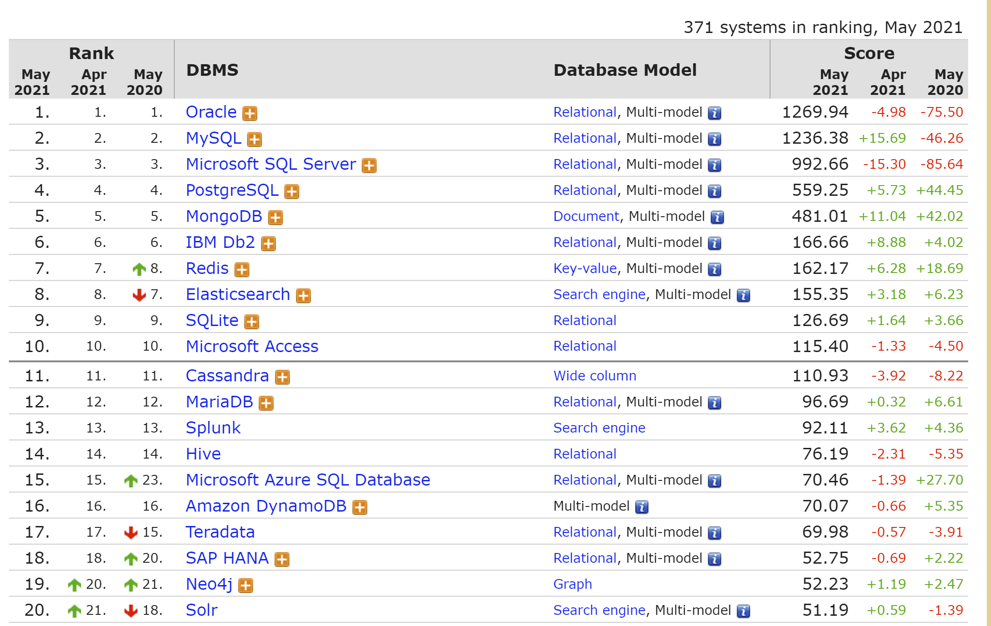
REDIS - Introduction
REDIS is one of the most popular NoSQL databases and certainly the most widely used in the key-value database segment.
According to the db-engines ranking, REDIS is the most popular key-value database, which also includes relational databases such as Oracle, MySQL and SQL Server.
https://db-engines.com/en/ranking

Slide 7
REDIS - Introduction
Storage-based NoSQL database engine
key/value.
Key("Example") → Value("A simple example")
Provides the possibility to store information in various data structures such as lists, sets or hashes.

Slide 8
REDIS - Introduction
Most popular features:
Speed: keeps information in RAM (although it can also keep it on disk).
Simplicity and flexibility.
Projects that need low response times.
Notes:
REDIS stands out mainly for its speed, simplicity and flexibility.
It allows information to be stored in RAM, as well as on disk.
It is generally used in projects that require a low response time.

Slide 9
REDIS - Introduction
REDIS is usually defined as a data structure server, although in its beginnings, honouring its name, it was a simple remote dictionary (REmote DIctionary Server).
It is BSD licensed, written in optimised C code and supports numerous development languages.
REDIS repository:
https://github.com/antirez/REDIS/tree/4.0
Notes:
REDIS repository is available in github.

Slide 10
REDIS - Characteristics
High speed: Data is stored in RAM, unlike other systems that store it on disk.
By eliminating access to these disks, delays are avoided: it is accessed and operated much faster.
Notes:
Some of the features of REDIS are its high speed, the fact that it can be stored in RAM helps a lot to achieve it. Unlike some of its competitors that only store it on disk.

Slide 11
REDIS - Characteristics
In-memory data structures:
With REDIS we can store keys of different data types and we have a maximum size of 512MB for a string, be it text or binary data.
It also supports lists of strings, unordered sets of strings, sorted sets by score, hashes and HyperLogLogs.
In other words, virtually any type of data can be stored in memory.

Slide 12
REDIS - Characteristics
Replication and persistence:
Master-slave architecture
Supports asynchronous replication: copy data to multiple slave servers.
Improved reads and recovery when the master server fails.
Notes:
In relation to Replication and persistence, REDIS has a Master-slave architecture.
Redis also supports asynchronous replication: copy data to multiple slave servers.
Improved reads and recovery when the master server fails

Slide 13
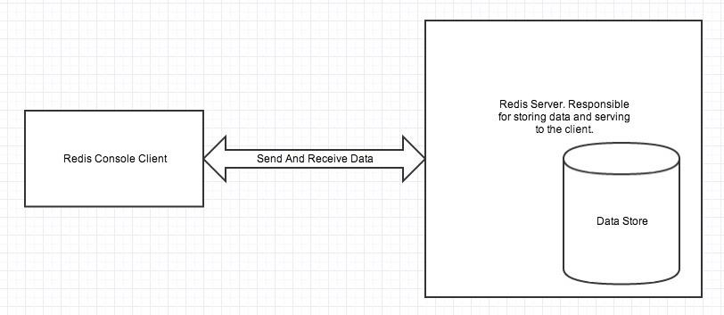
REDIS - Architecture
Simple instance:
Notes:
In this image we can see a simple instance of REDIS.
In the left side que have a REDIS Console Client that it can send and receive data from Redis Server.

Slide 14
REDIS - Architecture
Master-slave replication system :
Allows for scalability on the server.
A master can have multiple slaves, which in turn can accept connections from other slaves.
Non-blocking by the master (the master continues to accept queries even if the slaves are synchronising). Non-blocking also on the part of the slaves.
If the master goes down, the next slave becomes master.
Transparent recovery in case of failure.
Notes:
With regard to the replication system, REDIS has a master-slave system.
Allows for scalability on the server.
A master can have multiple slaves, which in turn can accept connections from other slaves.
Non-blocking by the master (the master continues to accept queries even if the slaves are synchronising). Non-blocking also on the part of the slaves.
If the master goes down, the next slave becomes master.
Transparent recovery in case of failure.

Slide 15
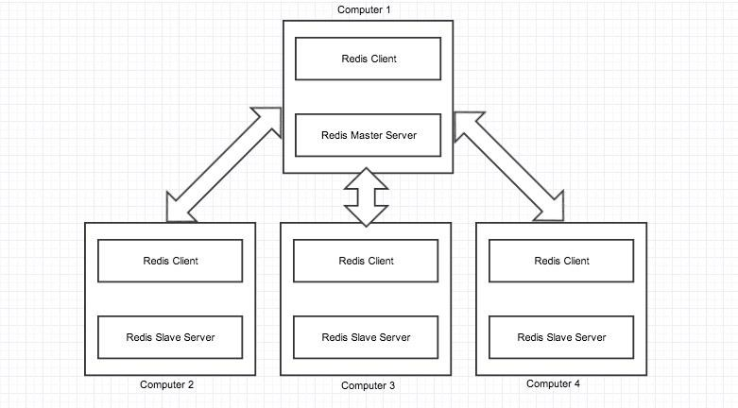
REDIS - Architecture
Master-slave replication system :

Slide 16
REDIS - Architecture
Persistence:
RBD (REDIS Database Backup): snapshots are used to copy data in memory to permanent storage (disk) at a specified interval.
AOF (Append Only File): all write operations received on the server (causes large log files) are stored.
SAVE command: forces the creation of a snapshot.

Slide 17
REDIS - Architecture
Performance:
Single-threaded (other systems create a process or fork for each new request).
To improve CPU performance, multiple REDIS instances can be started on the same server.

Slide 18
REDIS - Architecture
Limitations:
The main limitation is memory (data structures cannot be larger than memory). If memory is exceeded, swapping starts: it affects performance.
maxmemory option to limit the memory used (no new writes are allowed after that, but reads are allowed).

Slide 19
REDIS – Data structure
Basic commands:
set <key> <value>: The separator ":" is often used to create the key structure: students:unileon, title:1, title:2, author:1, author:2.
get <key>: Gets the value of a key (or (nil) if it does not exist).
Notes:
Dos puntos = colon

Slide 20
REDIS - Data structure
Strings:
These are the most basic structures available.
Maximum of 512 MB.
Common commands:
strlen <key>: value length calculation.
getrange <key> <start> <end>: substring in the given range
append <key> <value>: append <value> to the end of the existing value (or create a new one if there is none).
incr <key>: Increments the value by one (if possible)
decr <key>: decrements the value by one (if possible)
incrby <key> <inc> : Increments the value by <inc> (if possible)
decrby <key> <dec>: decrements by <dec> the value (if possible)

Slide 21
REDIS - Data structure
Hashes:
Collection of key-value pairs.
Particularly suitable for object storage.
hset <key> <field> <value> [<field> <value> ...]
hget <key> <field>

Slide 22
REDIS - Data structure
Hashes (other commands):
hmget <key> <field> [<field>...]: get the value of several fields.
hgetall <key>: get all fields and their values.
hkeys <key>: get only the fields.
hdel <key> <field> [<field>...]: removes the specified fields.

Slide 23
REDIS - Data structure
Lists:
They allow storing and manipulating a set of values given a specific key.
You can add values to the list, retrieve values, and manipulate values of a given position.
Lists maintain order and are efficient in performing operations based on their index. operations based on their index.
Values can be any type of data.

Slide 24
REDIS - Data structure
Lists (common commands):
lpush <key> <element> [<element>...]: Inserts one or more elements at the beginning of the specified list with key <key>.
lindex <key> <index>: Returns the <index> element of the list (negative numbers start counting from the end of the list).
linsert <key> BEFORE | AFTER <pivot> <element>: Inserts an element before or after the position specified with <pivot>.
llen <key>: Returns the length of the list.
lpop <key>: Returns the first element in the list and removes it from the list.
Lrange <key> <start> <stop>: Returns the specified range of the list.
Lrem <key> <count> <value>: Removes the first (or last if it is a negative number) <count> elements of value <value>. If <count> is 0, 22 removes all matches.

Slide 25
REDIS - Data structure
Sets:
Storage of unique values.
Order is not maintained.
Efficient operations (intersection, union...).

Slide 26
REDIS - Data structure
Sets (common commands):
sadd <key> <member> [<member>...]: Adds one or several values to the set.
scard <key>: Number of elements in the set.
sunion <key> [<key>...]: Returns the union of the sets.
sinter <key> [<key>...]: Returns the intersection of the sets.
sunionstore <dest><key>[<key>...]: Stores the union of the sets in <dest>.
sinterstore <dest><key>[<key>...]: Stores the intersection of the <dest> sets.

Slide 27
REDIS - Data structure
Ordered sets:
Similar to sets.
Each member is associated with a score, which is used to represent the order of the set from smallest to largest.

Slide 28
REDIS - Data structure
Ordered sets (common commands):
zadd <key> <score> <member> [<score> <member>...]: Adds one or values to the set, with their scores.
zcard <key>: Number of elements in the set.
zcount <key> <min> <max>: Number of elements in the set with scores between <min> and <max>.
zrank <key> <member>: Returns the position of <member> in the set, sorted in order of lowest to highest score.
zrevrank <key> <member>: Returns the position of <member> in the set, sorted from highest to lowest score.
Zrange <key><start><stop>: Returns the elements in the specified specified.

Slide 29
REDIS - Data structure
SORT command
Probably one of the most complex and powerful commands in REDIS.
It allows to emulate SQL queries.
It operates on lists, sets or sorted sets.
By default, it interprets double-precision floating point numeric values, and sorts them in ascending order.
Can be slow on large data sets.
Definition:
SORT <key> [BY <pattern>] [LIMIT <offset> <count>] [GET <pattern> [GET <pattern> ...]] [ASC|DESC] [ALPHA] [STORE <destination>]

Slide 30
REDIS - Data structure
SORT command
Simple usage: sort mylist / sort mylist ASC / sort mylist DESC
ALPHA usage: interprets String values for lexicographic sorting.
Use of LIMIT: Indicates from which element to display (<offset>) and how many elements to display (<count>).
Use of STORE: Indicates that you want to store the sorting output in <destination>.

Slide 31
REDIS - Data structure
SORT command
Use of BY (foreign keys): You specify a pattern, which includes the character, to indicate the key you want to use for sorting.
Example:
sadd user:123:favourite_restaurants_ids 200 365 104 455 333
set rest_rating_200 4.3
set rest_rating_365 4.0
set rest_rating_104 4.8
set rest_rating_455 4.7
set rest_rating_333 4.6
sort “user:123:favourite_restaurants_ids” by rest_rating_* DESC
1) 104
2) 455
3) 333
4) 200
5) 365

Slide 32
REDIS - Data structure
SORT command
Use of GET (foreign keys): You specify one or more patterns, including the * character, to indicate the fields you want to display.
Example (following the previous example):
set rest_name_200 “Ruby Tuesday”
set rest_name_365 “TGI Friday”
set rest_name_104 “Applebee’s”
set rest_name_455 “Red Lobster”
set rest_name_333 “Boiling Crab”
sort “user:123:favourite_restaurants_ids” by rest_rating_* DESC get rest_name_*
“Applebee’s”
“Red Lobster”
“Boiling Crab”
“Ruby Tuesday”
“TGI Friday”

Slide 33
REDIS - Data structure
Other commands:
The full list of commands can be found at https://REDIS.io/commands.

Slide 34
REDIS – Development tools
HyperLogLog:
Probabilistic data structure used to provide the cardinality of a set (count of unique values).
Approximate results, low memory usage (about 12 kilobytes, about 0,81% error rate).
Useful for obtaining the number of unique values in very large datasets (usually a computationally intensive operation): users of a website, count of unique words in a book, etc.

Slide 35
REDIS – Development tools
HyperLogLog (commands):
pfadd <key> <element> [<element>...]: Inserts elements into an HLL. Returns 1 if its cardinality is changeable, 0 otherwise.
pfcount <key>[<key>...]: Count elements in an HLL. With multiple keys it returns the sum of their cardinalities.
pfmerge <destkey> <sourcekey>[<sourcekey>...]: Stores in <destkey> the union of the HLLs stored in <sourcekey>.

Slide 36
REDIS – Development tools
HyperLogLog (persistence):
HyperLogLog is basically a REDIS String.
It can be fetched with GET and stored as a String with SET.
It allows copying and persistence of the data structure.

Slide 37
REDIS – Development tools
Pub/Sub
Messaging pattern in which multiple Publishers send messages to multiple Subscribers, who listen to messages on specific channels via the server software.
The REDIS client can subscribe to as many channels as it wishes.
One of the most widely used message queuing patterns, mainly for instant messaging systems.

Slide 38
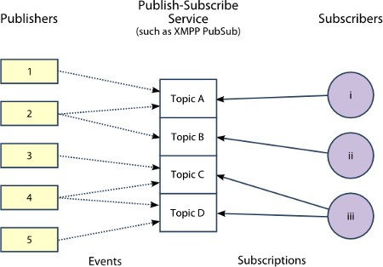
REDIS – Development tools

Slide 39
REDIS – Development tools
Pub/Sub (commands)
publish <channel><message>: Publication of a message in a channel.
subscribe <channel>[<channel>...]: Subscription to one or more channels.
psubscribe <pattern>[<pattern>...]: Subscription to channels in a pattern.
unsubscribe [<channel>[<channel>...]]: Unsubscribe to one or more (or all) channels (or all if none is specified).

Slide 40
REDIS – Development tools
Transactions
Execution of a group of commands in a single step.
Sequential execution as a single isolated operation (no other request shall be served in the middle of a transaction).
Atomic operation (all or no commands are processed).

Slide 41
REDIS – Development tools
Transactions (commands)
multi: Marks the start of a transaction. From then on, all commands will be queued until the transaction is executed.
exec: Executes the transaction and returns to the normal state.
discard: Aborts the transaction (removes the command queue and returns to the normal state).

Slide 42
REDIS – Development tools
TTL key system
Certain specific keys in REDIS that indicate a specific life time, after which they are after which they delete themselves.
Useful to avoid filling databases with unneeded data.
Atomic counters
Ensure that no inconsistent results are created.

Slide 43
REDIS – Development tools
LUA
Lightweight but powerful, structured and imperative scripting language.
Great versatility.

Slide 44
REDIS – Data modelling
Traditional modelling
Table-based.
Predefined data by columns.
Predefined model before data insertion.
SQL queries.

Slide 45
REDIS – Data modelling
REDIS modelling
There is no predefined data.
Rows can be collected under a common key.
The key can run around the item name:
shop:items:Gorgeus-Water-Mug
shop:items:Handcrafted-Trees-Mug

Slide 46
REDIS – Data modelling
REDIS modelling
By taking advantage of hashes, many non-indexed fields with values (each field must have a value) can be used.
Basic hash with 3 parts: KEY / FIELDS / VALUES:
hmset shop:items:Handcrafted-Trees-Mug artist "Martin Wessely" price 10.99 name "Handcrafted Trees Mug" description "Handcrafted Mug" manufacturer OHara-Group itemType mug productImg mug- 400_002e1ecb8bd2.jpg

Slide 47
REDIS – Programmatic access
Connections to REDIS can be made with all kinds of programming languages.
One of the simplest and most widely used is Python: pip install REDIS
Consult at https://pypi.python.org/pypi/REDIS
import REDIS
r = REDIS.REDIS(host=“localhost”, port=6379, password=“”) r.set('foo', 'bar')
value = r.get('foo') print(value)

Slide 48
REDIS – Clustering
A set of connected computers working together in such a way that, in many respects, they function as a single system.
Motivations:
Scalability
Performance
Availability
Increased effort in:
Management
Maintenance
Security

Slide 49
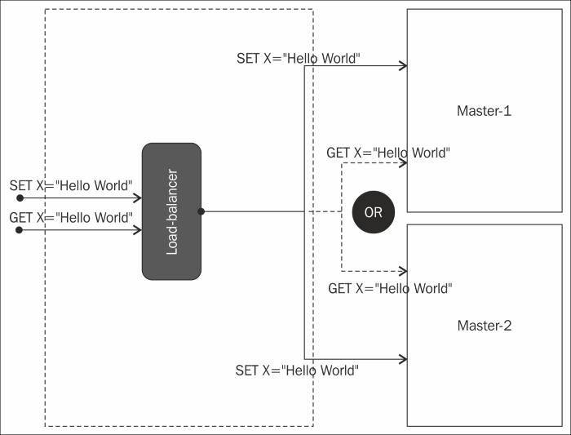
REDIS – Clustering
Master-Master Pattern:

Slide 50
REDIS – Clustering
Master-Master Pattern:
High performance (need for prior load balancing, not provided by REDIS).
High availability, dependent on the number of master nodes (state is maintained on all nodes).
Scalability compromised by the process of adding a new node: high impact on availability.
Management: high effort, as there is no mechanism offered by REDIS to implement this pattern.
Low security: passwords in plain text, no support for encryption. Command obfuscation is possible.

Slide 51
REDIS – Clustering
Master-Master Pattern (disadvantages):
Planned stops (dropping or adding nodes).
Complex horizontal scaling (need for detailed planning).

Slide 52
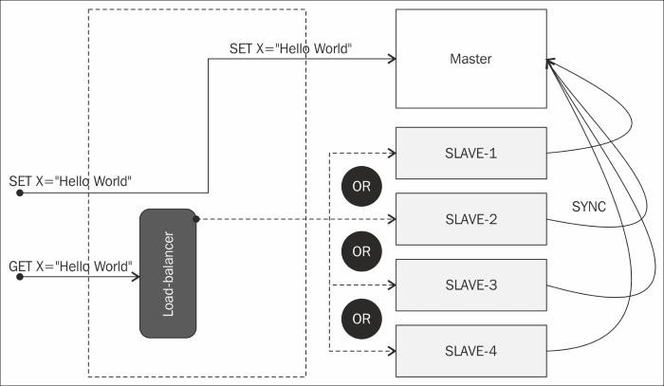
REDIS – Clustering
Master-Slave Pattern:

Slide 53
REDIS – Clustering
Master-Slave Pattern:
Frequent reads (performed on the slaves, balancing the load), not so frequent writes (performed on the master).
Data that can fit on the hardware offered by the master.
Horizontal scalability.
Increased latency when replicating data to slaves.
Especially used in the use of REDIS for the implementation of caches.

Slide 54
REDIS – Clustering
Master-Slave Pattern:
High performance (load balancing has to be provided by another application).
Simple availability at the slaves (if one goes down there are more).
Complex availability at the master (writes are stopped):
Pre-master message queue.
Sentinel: Mechanism provided by REDIS.
Scalability (only affects performance): new slaves must have similar hardware capabilities to the master, and must be registered with the upstream load balancer.
Management: Lower effort (mechanism provided by REDIS, so replication and data loading on slaves is covered). Management of master and load balancer/client adapters.
Security: Similar to Master-Master pattern.

Slide 55
REDIS – Clustering
Master-Slave Pattern (disadvantages):
One of the biggest problems is the amount of data to manage.
Hardware capacity and vertical scalability of the master.
Hardware capacity of the slaves.
Data copy latency: stale data.

Slide 56
REDIS – Clustering
REDIS Sentinel:
Independent REDIS node that manages fault tolerance.
It keeps track of the master and slaves.
If the master goes down, it promotes a slave to become a master.
Typically, multiple Sentinel nodes are used:
The eventuality of a Sentinel node going down is controlled.
A slave is promoted if several Sentinel nodes have detected the downfall of the master.
The process is automatic and transparent to the user.

Slide 57
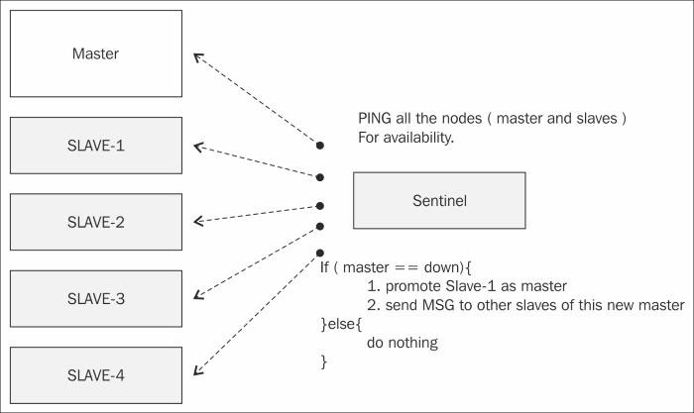
REDIS – Clustering
REDIS Sentinel:

Slide 58
REDIS – Clustering
REDIS Sentinel:
Usage: sentinel monitor <master-group-name> <ip> <port> <quorum> <quorum>
<master-group-name>: Master name
<ip> <port>: IP and port of the master
<quorum>: Number of Sentinels that have to detect the master's downtime in order to initiate a recovery (if possible).
For that recovery, most Sentinels have to be active (reachable) and vote for the lead Sentinel that will guide the recovery.

Slide 59
REDIS – Clustering
REDIS Sentinel Options:
<down-after-milliseconds>: Minimum time in milliseconds for the Sentinel to start considering that the node is down.
<parallel-syncs>: Number of replicas that can be reconfigured at the same time during a recovery (management operation to service the new master). Normally given a value of 1 to avoid latency issues.
Sentinel documentation: https://REDIS.io/topics/sentinel

Slide 60
REDIS – Use cases
Caches:
Web pages:
Can be used as a cache of HTML pages or fragments of HTML pages.
Access to them is accelerated.
Reduced load on Web and application servers.
Economic savings (HW and SW licences).
Databases:
Results of very frequent queries, with little changing information changing or whose updating is not critical.
Reduces the load on operational databases.

Slide 61
REDIS – Use cases
Storage of user sessions:
Very fast access sessions.
Session identifier + session access information.
Reduces latency time and access to other databases.
An expiry time can be associated to each key:
expire <key> <seconds>.

Slide 62
REDIS – Use cases
Storage of shopping carts:
Similar to the user session store.
Items contained in user basket + login information.
Reduced latency time.

Slide 63
REDIS – Use cases
Counters and statistics:
Real-time management.
Support for concurrent and atomic management.
Examples:
Visualisations of a product.
Voting.
Access to a resource.

Slide 64
REDIS – Use cases
List of recent items:
Displays the latest updates of an item made by users.
Normally costly for operational DBs (especially with high volume of information).
In REDIS: volume independent.
Examples:
Last comments on a post.
Last images uploaded.
Recently viewed items from a catalogue.

Slide 65
REDIS – Use cases
Main database:
For specific cases, such as microservices.
Leverages its modelling power.
Specialised solutions, simple to implement and maintain.
High performance.

Slide 66
REDIS – Examples of use
Twitter:
Maintenance of users' timeline.
Updating in the shortest possible time.
Critical operation.
Pinterest:
Maintenance of user information and boards followed by each user.
Trello:
Maintenance of ephemeral information.
Shared among all its servers.

Slide 67
REDIS – Graphic tools
Terminal: REDIS-cli
FastoREDIS: http://fastoREDIS.com
REDIS Desktop Manager: https://REDISdesktop.com

Slide 68
Recommended bibliography
Book: Learning REDIS:
https://learning.oreilly.com/library/view/learning-REDIS/9781783980123/
REDIS 4.x Cookbook:
https://learning.oreilly.com/library/view/REDIS-4x-cookbook/9781783988167/
Official REDIS documentation:
https://REDIS.io/

Slide 69
Jupyter notebook example

Slide 70

My social networks
Mis redes:
https://www.jabenitez.com
https://www.jabefitness.com
Ig: @jabenitez88
Ig: @jabeteacher
Tw: @jabenitez88
Youtube, Linkedin, Facebook,
Researchgate…
www.salbis.es

